Slide 1
Chapter: 8.5
Calculating gases in chemical reactions

Slide 2
In Chapter5 , mass calculations based on amounts of products and reactants were amounts of reactants and products were considered.
The calculations needed to use the mole relationships given by coefficients in a balanced chemical equation in order to determine amounts of reactants and products.
This relationship can now be extended to include volume of gases.

Slide 3
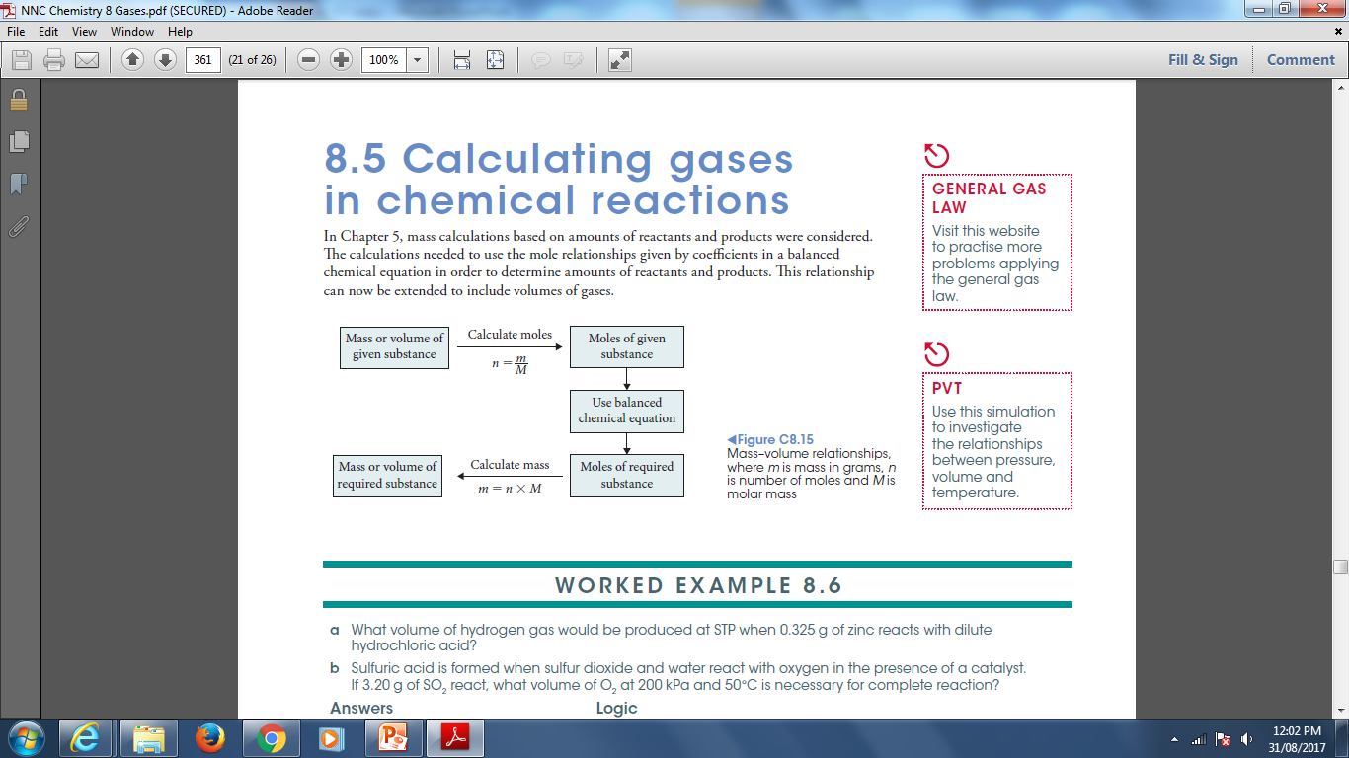

Slide 4
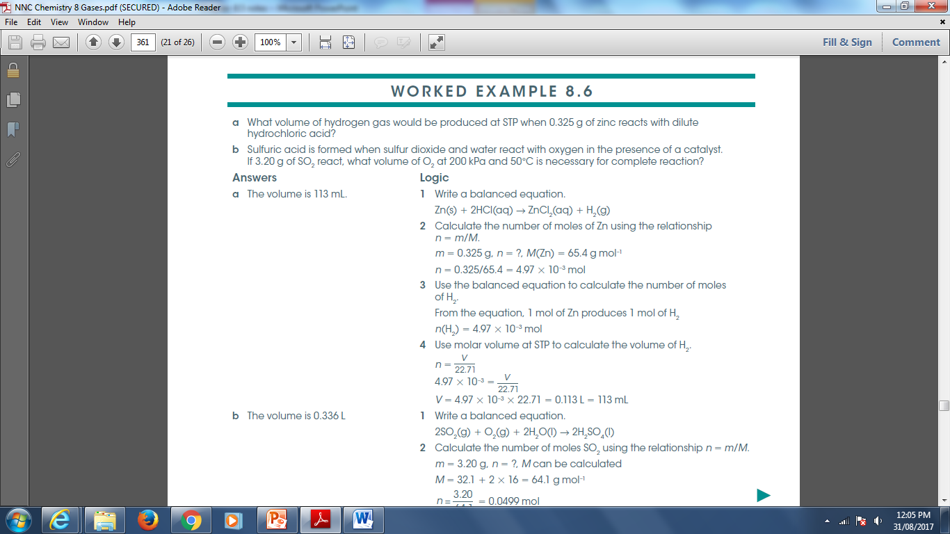

Slide 5
